Slide 1
Welcome to the Skills and Career Navigator
Powered by the Ontario Vehicle Innovation Network (OVIN)

Slide 2
About OVIN
Ontario Vehicle Innovation Network (OVIN)
OVIN is the Government of Ontario’s bellwether initiative to support the future of the automotive and mobility sector.

Slide 3
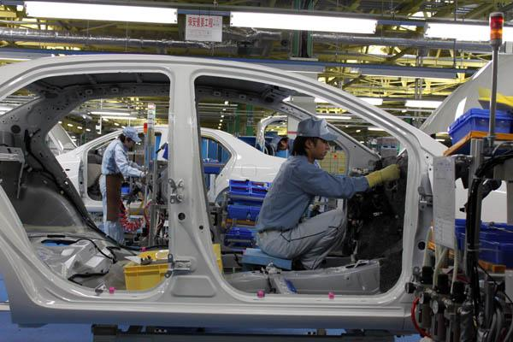
What can this tool do for you?
Young Learners
High School and Middle School Students
Post-Secondary Students
Professionals
Employers

Slide 4
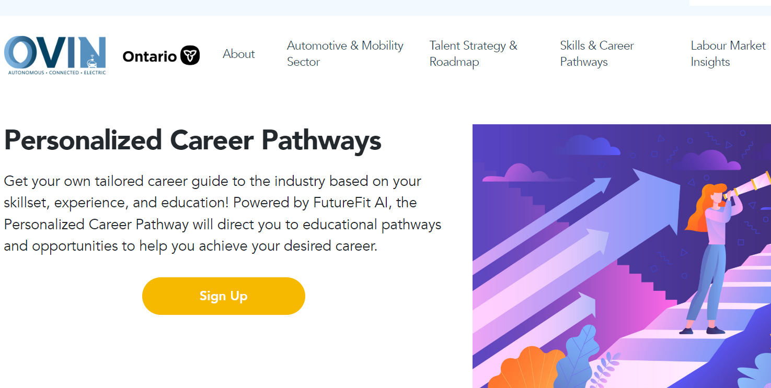

Slide 5
Career Pathways

Slide 6
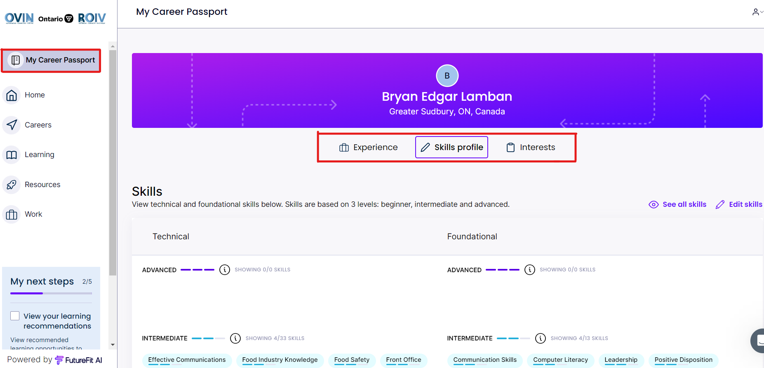
Career Passport

Slide 7
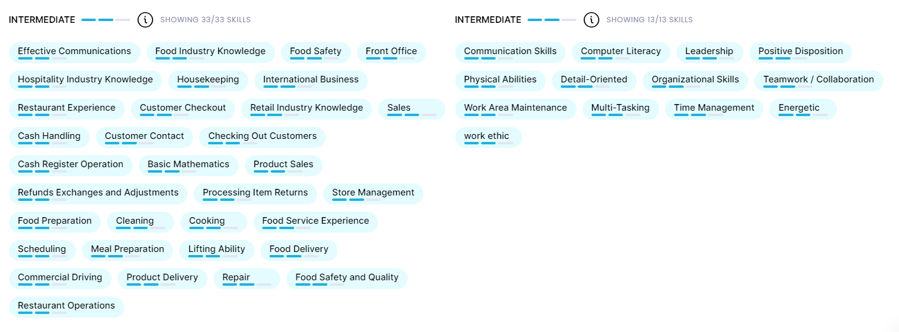
Skills profile

Slide 8
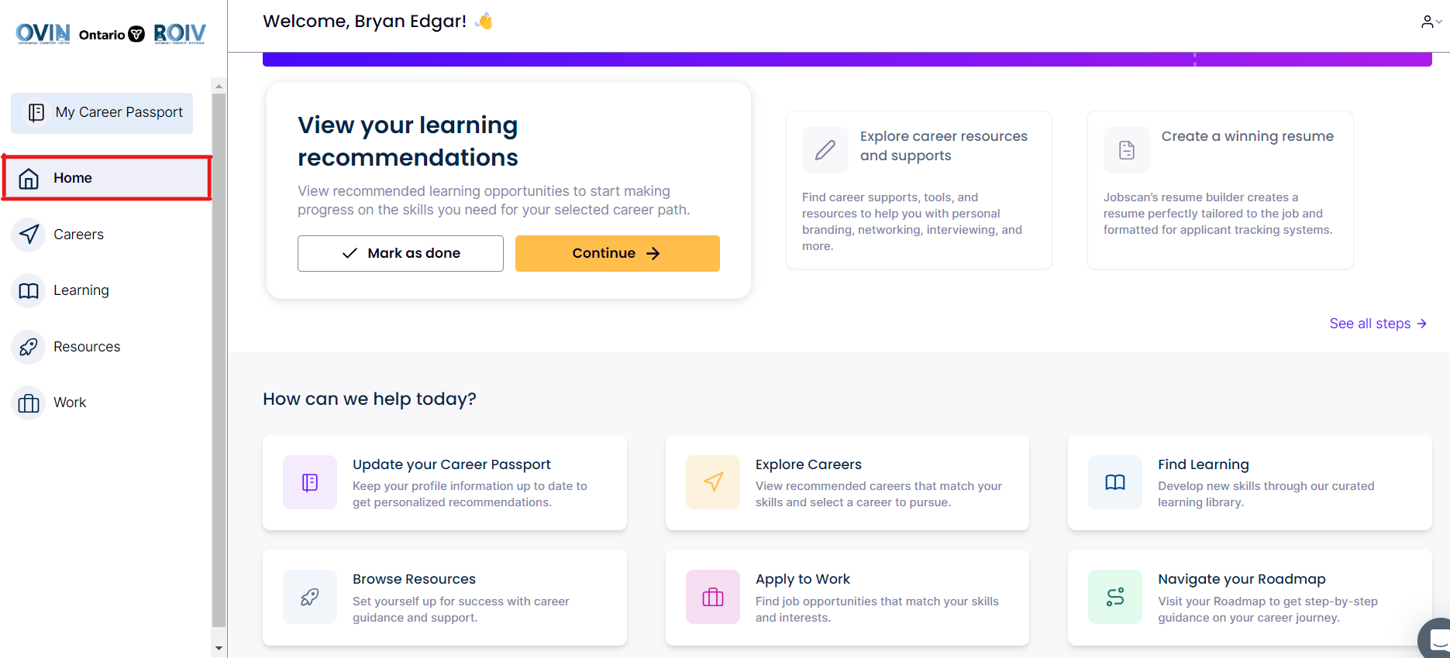

Slide 9
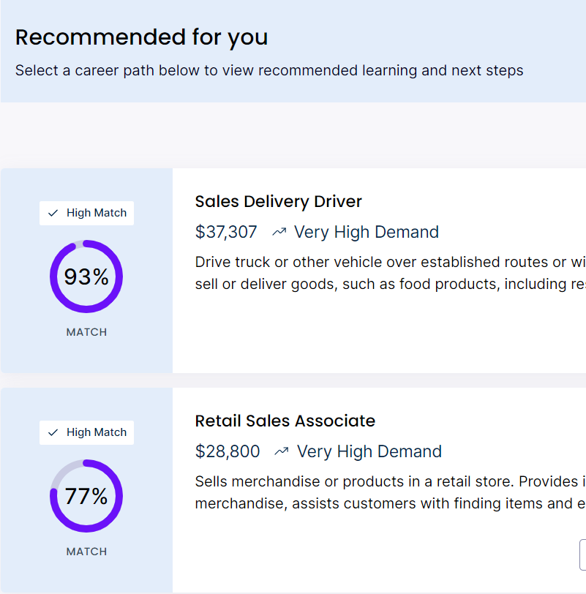
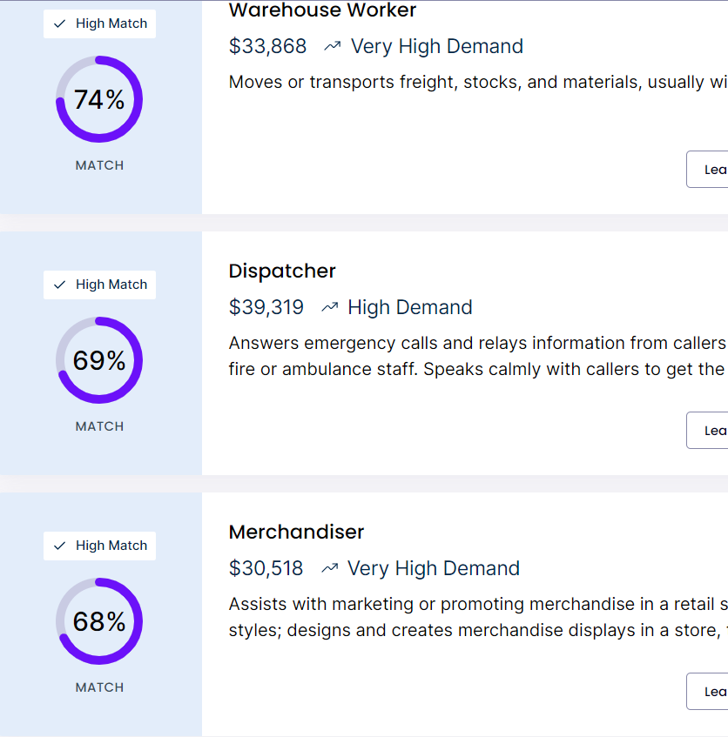

Slide 10
OVIN Navigator Website

